Slide 1
Announcements
Cool things in the world of Angular
November, 2014
http://goo.gl/0RfNZM

Slide 2
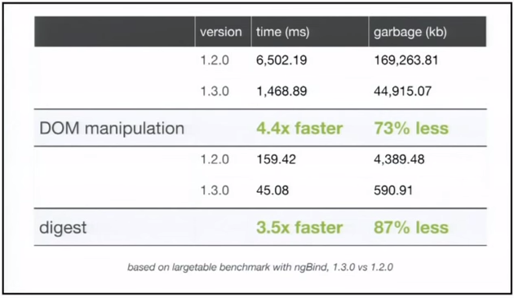
AngularJS 1.3.0! (+1.3.1, 1.3.2, 1.3.3)
Highlights:
Faster, faster, faster
Better, easier Forms
ngAria
Angular 1.3 Video from ngEurope

Slide 3
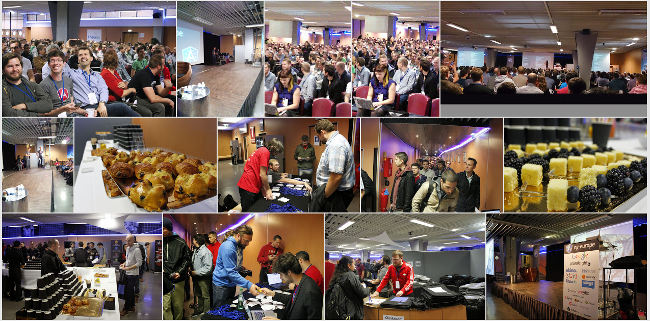
ngEurope

Slide 4

ngEurope
Highlights:
Keynote
AngularJS 1.3
Material Design
New Router
Accessibility
Angular 2
AtScript
Q&A
46 videos on YouTube

Slide 5
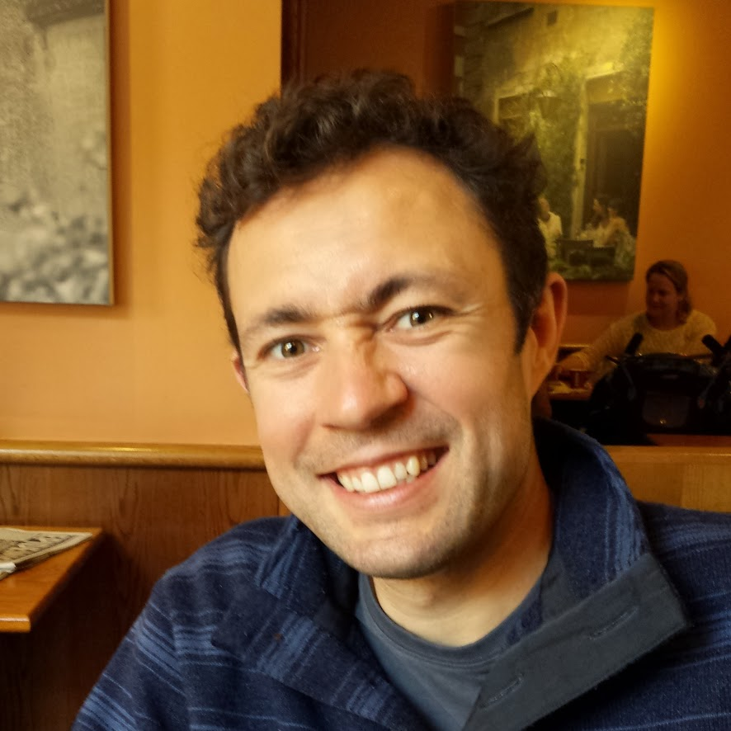
Angular 1.x plans
Features in works:
Internationalization
New Router
Material Design
New Angular 1.x Lead:
Pete Bacon Darwin

Slide 6
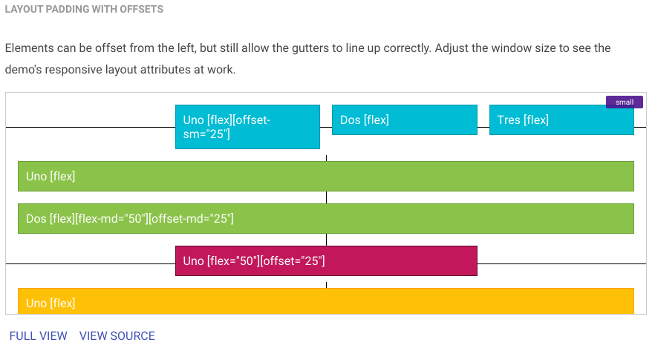
Material Design - material.angularjs.org
Layout

Slide 7
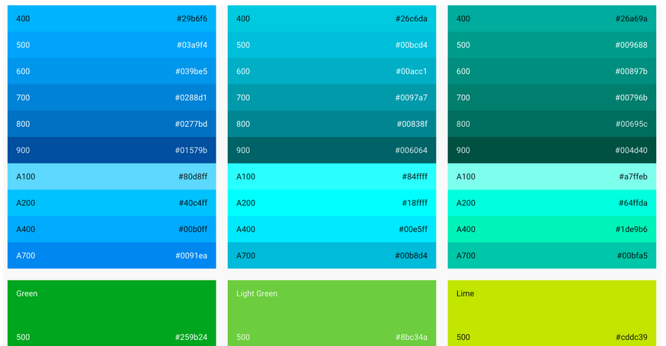
Material Design
Color Themes

Slide 8
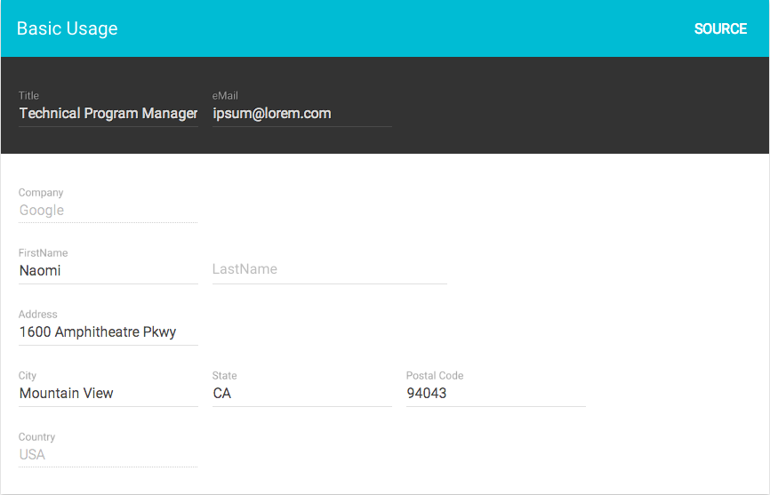
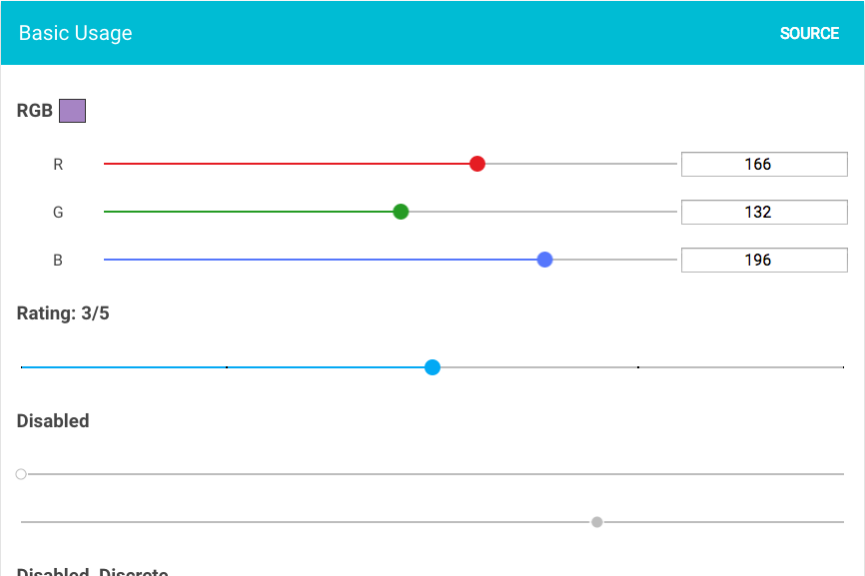
Material Design
Many more widgets

Slide 9

Adventures in Angular
Interview with Angular team
Using ES6 with Angular
AngularJS + KendoUI
Firebase
WebGL
And more

Slide 10

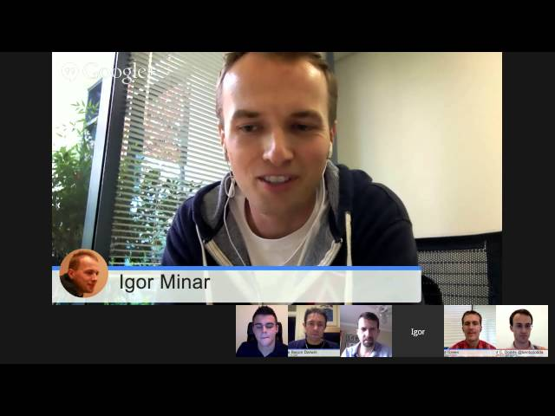
Angular Air
ng-air.github.io

Slide 11
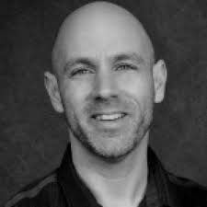
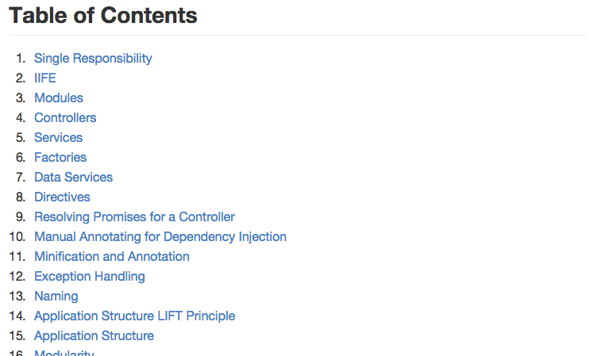
Style Guide
John Papa's AngularJS Style Guide

Slide 12

ng-conf Tickets for Sale
tickets.ng-conf.org

Slide 13
ng-fixit #1
Saturday 11/22, 9am - 3pm
Downtown San Francisco
Sign up: http://goo.gl/q9c6fG
Space is limited!

Slide 14
Thanks!
http://goo.gl/0RfNZM

